Slide 1
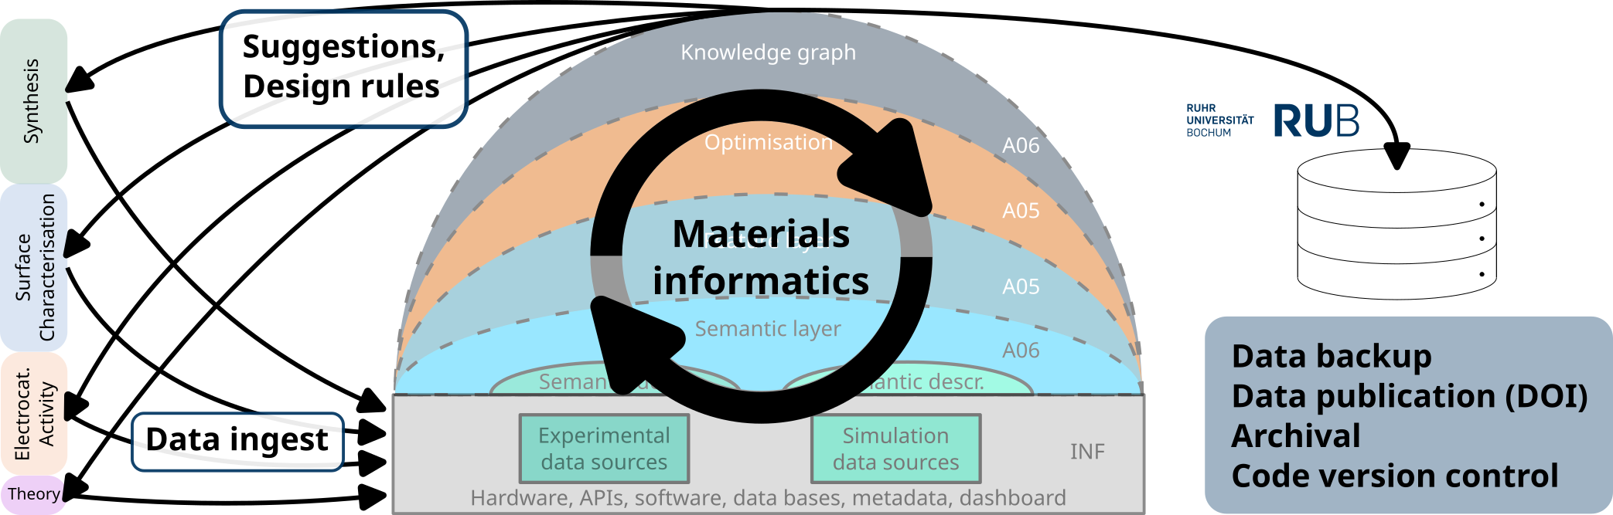
INF
FAIR collection, curation, and management of multidimensional research data
1

Slide 2
Virtual Electrochemist
2

Slide 3

Virtual Electrochemist
Start Page
3

Slide 4

Virtual Electrochemist
Page for receiving the consent from the user that will use the details recorded for postprocessing analysis.
4

Slide 5
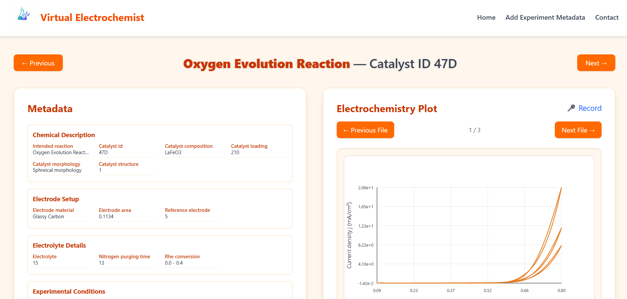
Virtual Electrochemist
Experiment details so the participants give the feedback records.
5

Slide 6
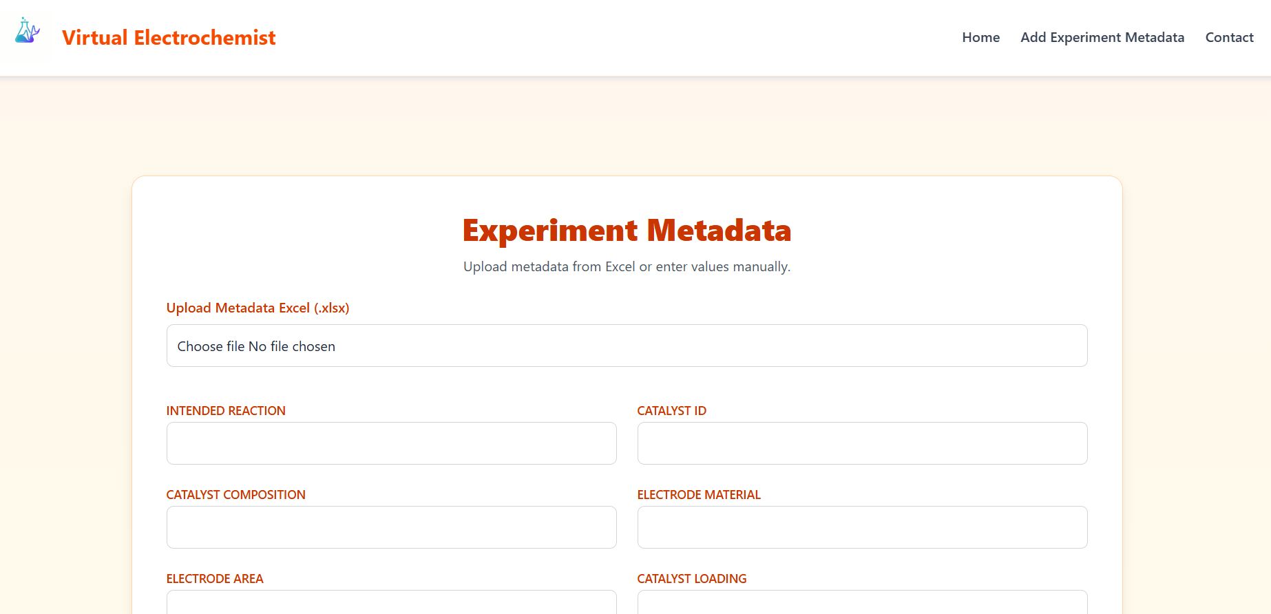
Virtual Electrochemist
Page to add the experimental metadata.
6

Slide 7
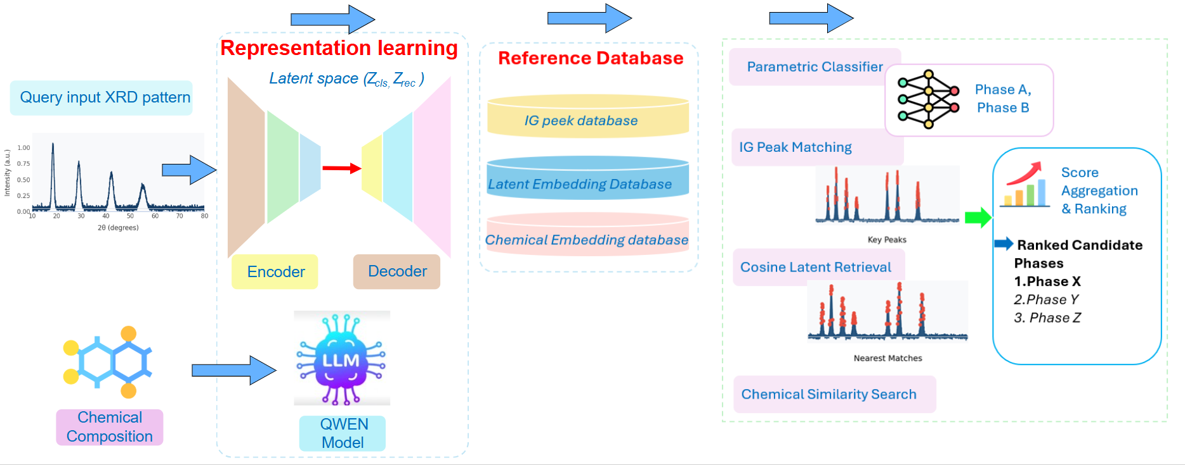
XRD
An autoencoder encodes the XRD pattern into a latent representation. If the chemical composition is available, a Qwen model processes it to generate a complementary embedding.
7

Slide 8
XRD
A query XRD pattern, together with the chemical composition, is first passed into a representation learning model (encoder–decoder architecture, based on a Qwen LLM). The model maps the input into a latent space embedding that captures structural and chemical features.
The learned representation is then compared against a reference database, which includes:
IG peak database
Latent embedding database
Chemical embedding database
In the final stage, multiple matching strategies are applied, including:
Parametric classification
IG peak matching
Cosine similarity retrieval in latent space
Chemical similarity search
The results are aggregated and ranked, producing a ranked list of candidate phases (e.g., Phase X, Phase Y, Phase Z) based on similarity scores.
8

Slide 9
Dataset
The dataset was collected from the Crystallography Open Database (COD) and the Materials Project. In total, we obtained 49,000 CIF files for crystal system classification. To enhance the dataset, we applied data augmentation by generating 15 additional samples from each CIF file.
For space group classification, we used 34,500 CIF files covering 23 space groups. These were carefully selected to construct a balanced dataset suitable for classification tasks.
9

Slide 10
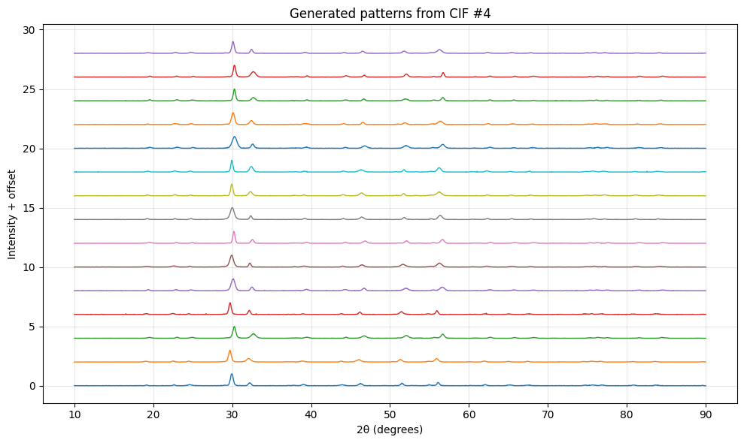
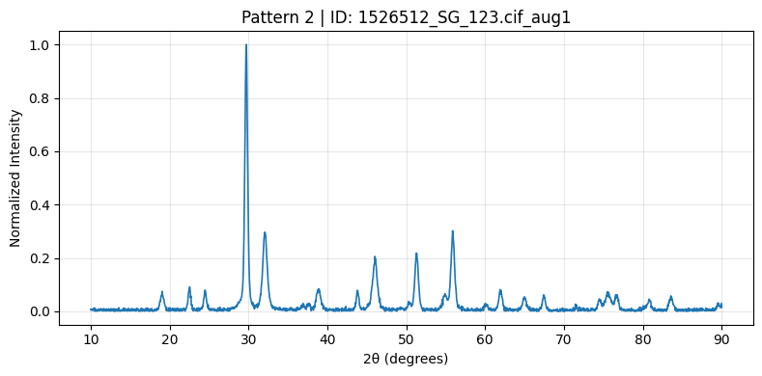
Augmentation example
10

Slide 11
Model Performance for Crystal System
The model demonstrates strong performance on the primary dataset, achieving a reconstruction error of 0.000341 on the test set. When evaluated on external datasets, the reconstruction errors remain low (0.0004 for RRUFF and 0.00037 for NiCoAl), suggesting robust generalization across different data distributions.
Test Dataset | Number of CIFS | Model Accuracy | Cosine similarity
10% holdout set from the (MP) and COD dataset | 4,900 | 95.6% | 70%
NiCoAl dataset | 31 | 94.4% | 62.3%
RRUFF | 105 | 72.0% | 66.2%
11

Slide 12
Model Performance for Space Group
The observed decrease in space group prediction accuracy can be attributed to the inherent difficulty of multi-class classification across 23 distinct space groups. Fine-grained structural distinctions between space groups make this a significantly more challenging task compared to crystal system classification.
Test Dataset | Number of CIFS | Model Accuracy | Cosine similarity
10% holdout set from the (MP) and COD dataset | 4,900 | 88.6% | 70%
NiCoAl dataset | 31 | 46.4% | 40.8%
RRUFF | 105 | 46% | 28%
12

Slide 13
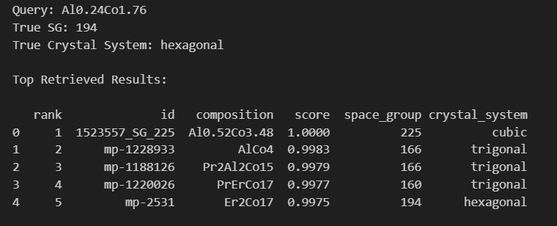
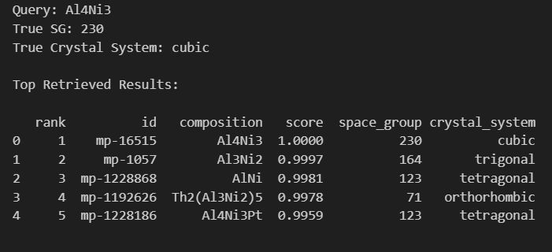
Composition similarity
Cosine similarity measures the angular similarity between ℓ₂-normalized embedding vectors, capturing compositional proximity independent of magnitude. Higher similarity values indicate chemically related compositions in the learned embedding space.
The examples below show retrieval results using a NiCoAl-based query composition. In both cases, the correct crystal system and space group appear within the top-5 retrieved candidates, demonstrating the effectiveness of embedding-based compositional retrieval.
13

Slide 14
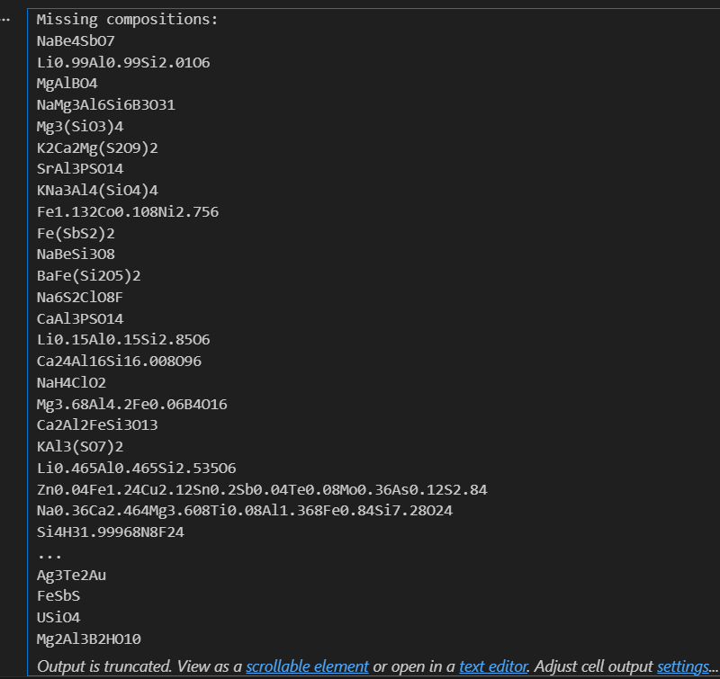
RUFF Dataset Composition Coverage
This screenshot highlights that most compositions from the RRUFF dataset are not present in the compositional data collected from the Materials Project (MP) and the Crystallography Open Database (COD).
Despite this limited compositional overlap, the model is still able to generalize and perform classification with acceptable accuracy, demonstrating robustness to distribution shift.
14

Slide 15
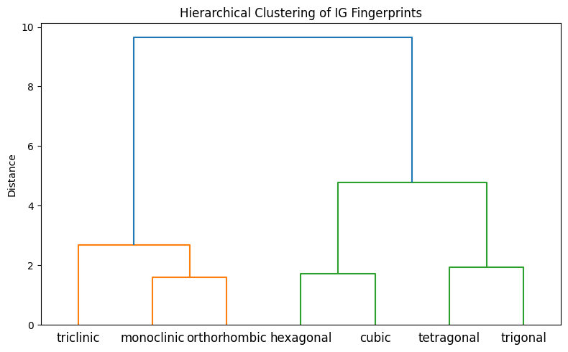
Hierarchical Clustering of IG Fingerprints
The dendrogram shows clustering of mean Integrated Gradients (IG) attribution patterns for the seven crystal systems.
Two main groups emerge: low-symmetry systems (triclinic, monoclinic, orthorhombic) cluster together, while higher-symmetry systems (hexagonal, cubic, tetragonal, trigonal) form a separate branch.
This indicates that the model relies on distinct diffraction regions to differentiate low- and high-symmetry crystal systems, reflecting meaningful structural relationships in its learned representations.
15

Slide 16
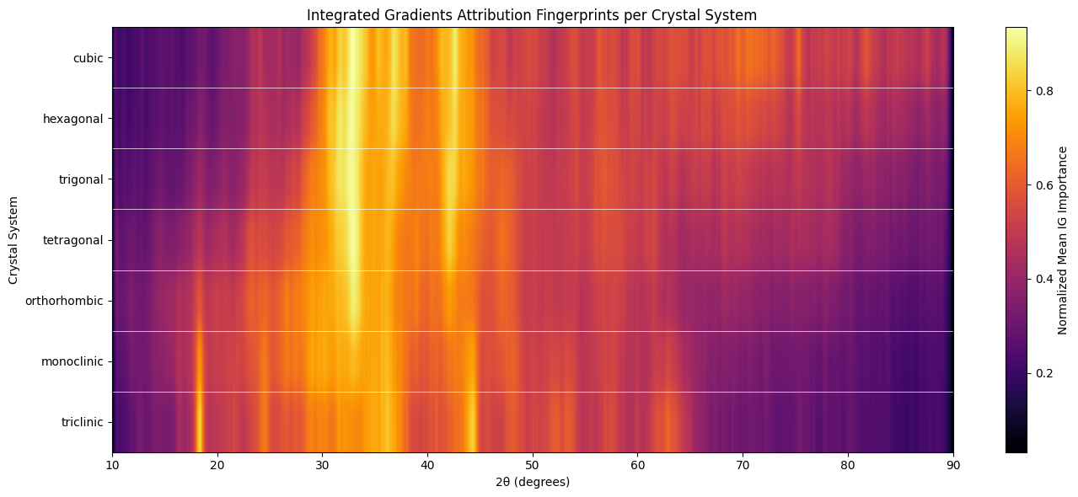
Integrated Gradients Attribution Fingerprints per Crystal System
The heatmap displays the normalized mean IG importance across 2θ for each crystal system. Bright regions mark diffraction angles most influential in the model’s decisions, revealing symmetry-dependent attribution patterns.
16

Slide 17
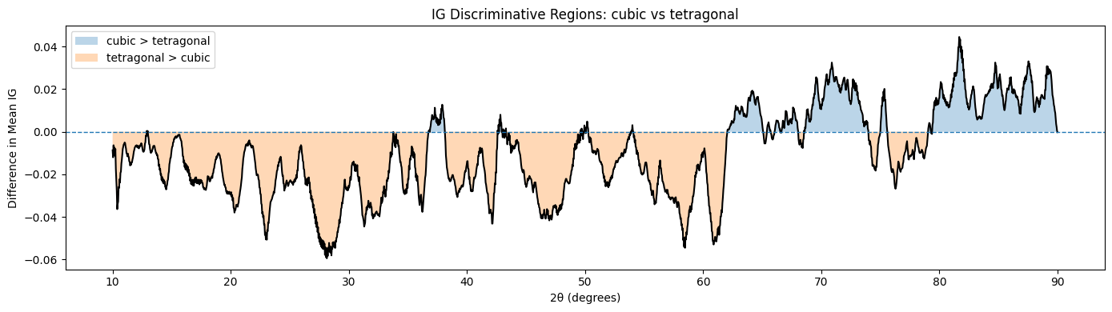
IG Discriminative Regions: Cubic vs. Tetragonal
The plot shows the difference in mean IG importance between cubic and tetragonal systems across 2θ. Positive regions indicate angles more important for cubic classification, while negative regions favor tetragonal. These localized differences reveal the diffraction regions driving the model’s distinction between the two symmetries.
17

Slide 18
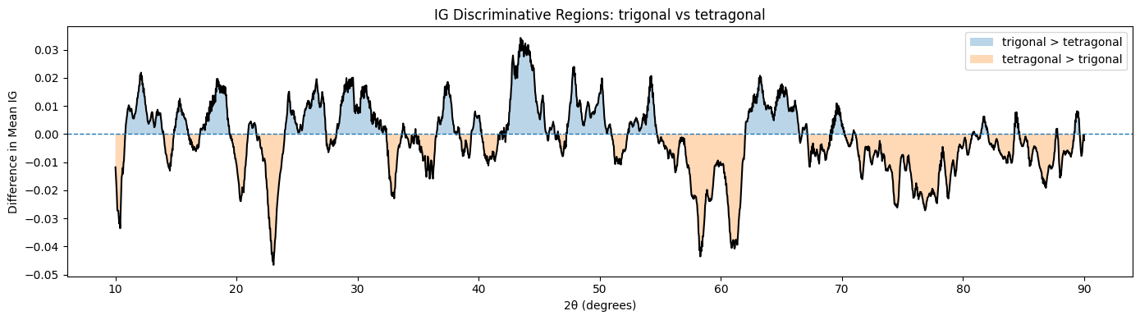
IG Discriminative Regions: Trigonal vs. Tetragonal
The plot shows the difference in mean IG importance between trigonal and tetragonal crystal systems across 2θ. Positive regions indicate diffraction angles more influential for trigonal classification, while negative regions favor tetragonal. The alternating localized peaks highlight the specific diffraction regions the model uses to distinguish between these two symmetry classes..
18

Slide 19
IG Discriminative Regions: Trigonal vs. Tetragonal
The plot shows the difference in mean IG importance between trigonal and tetragonal crystal systems across 2θ. Positive regions indicate diffraction angles more influential for trigonal classification, while negative regions favor tetragonal. The alternating localized peaks highlight the specific diffraction regions the model uses to distinguish between these two symmetry classes..
19

Slide 20
IG Discriminative Regions: Trigonal vs. Tetragonal
The plot shows the difference in mean IG importance between trigonal and tetragonal crystal systems across 2θ. Positive regions indicate diffraction angles more influential for trigonal classification, while negative regions favor tetragonal. The alternating localized peaks highlight the specific diffraction regions the model uses to distinguish between these two symmetry classes..
20

Slide 21
Feedback and Questions
Contact
E-Mail: Doaa.Mohamed@ruhr-uni-bochum.de

